Slide 1
Mecklenburg County
Enterprise Plan Management Accela Integrations Solution Assessment
(Technology Matrix, Solution Blueprint and Cost Estimate)
March 18th, 2019

Slide 2
Estimator - Feature Request and Technology Matrix
Feature and Technology Matrix
Feature | Process | Feature Request | Technology | Existing Capability | New Capability / Technology
FR1 | Estimation | GAP Communicate questionsAs a Estimator | MVC App/Web API/SQL PaaS/Azure AD App Registration/API Gateway/*O365 Exchange/Enterprise Logging | P
FR2 | Estimation | Agency Estimation As an Trade Estimator | MVC App/Web API/SQL PaaS/Azure AD App Registration/API Gateway/InRule BRE/Enterprise Logging/Azure Key Vault | P
FR3 | Estimation | Answer questions As a CE Customer | MVC App/Web API/SQL PaaS/Azure AD App Registration/API Gateway/*O365 Exchange/Enterprise Logging/Azure Key Vault | P
FR4 | Estimation | Assign multiple plan reviewers by trade As a Estimator | MVC App/Web API/SQL PaaS/Azure AD App Registration/API Gateway/Enterprise Logging/Azure Key Vault | P
FR5 | Estimation | Assign plan reviewers by trade As a Estimator | MVC App/Web API/SQL PaaS/Azure AD App Registration/API Gateway/Enterprise Logging/Azure Key Vault | P
FR6 | Estimation | Change assigned coordinator As a coordinator | MVC App/Web API/SQL PaaS/Azure AD App Registration/API Gateway/Enterprise Logging/Azure Key Vault | P
FR7 | Estimation | Change assigned coordinator As a Estimator | MVC App/Web API/SQL PaaS/Azure AD App Registration/API Gateway/Enterprise Logging/Azure Key Vault | P
FR8 | Estimation | City fire agency is estimated by code enforcement As a Estimator | MVC App/Web API/SQL PaaS/Azure AD App Registration/API Gateway/InRule BRE/Enterprise Logging/Azure Key Vault | P
FR9 | Estimation | Complete Estimation As an Agency | MVC App/Web API/SQL PaaS/Azure AD App Registration/API Gateway/InRule BRE/Enterprise Logging/Azure Key Vault | P
FR10 | Estimation | County fire estimation As a County Fire Agency | MVC App/Web API/SQL PaaS/Azure AD App Registration/API Gateway/InRule BRE/Enterprise Logging/Azure Key Vault | P
FR11 | Estimation | County shop drawings default As a County Fire Estimator | MVC App/Web API/SQL PaaS/E5Azure AD App Registration/API Gateway/Enterprise Logging | P
FR12 | Estimation | Edit estimated hours As a Estimator | MVC App/Web API/SQL PaaS/Azure AD App Registration/API Gateway/InRule BRE/Enterprise Logging/Azure Key Vault | P
FR13 | Estimation | Estimate re-review timeAs a plan reviewer | MVC App/Web API/SQL PaaS/Azure AD App Registration/API Gateway/Enterprise Logging/Azure Key Vault | P

Slide 3
Estimator - Feature Request and Technology Matrix (cont.)
Feature and Technology Matrix
Feature | Process | Feature Request | Technology | Existing Capability | New Capability / Technology
FR14 | Estimation | Estimation for townhomes. As a Townhome Estimator | MVC App/Web API/SQL PaaS/Azure AD App Registration/API Gateway/InRule BRE/Enterprise Logging/Azure Key Vault | P
FR15 | Estimation | Estimation is not applicable As an estimator | MVC App/Web API/SQL PaaS/Azure AD App Registration/API Gateway/Enterprise Logging/Azure Key Vault | P
FR16 | Estimation | Exclude a trade from review As an Estimator | MVC App/Web API/SQL PaaS/Azure AD App Registration/API Gateway/Enterprise Logging/Azure Key Vault | P
FR17 | Estimation | Exclude plan reviewers by trade As a Estimator | MVC App/Web API/SQL PaaS/Azure AD App Registration/API Gateway/Enterprise Logging/Azure Key Vault | P
FR18 | Estimation | GAP Information for estimation As a Estimator | MVC App/Web API/SQL PaaS/Azure AD App Registration/API Gateway/Enterprise Logging | P
FR19 | Estimation | Hours for each trade review As an Estimator | MVC App/Web API/SQL PaaS/Azure AD App Registration/API Gateway/InRule BRE/Enterprise Logging | P
FR20 | Estimation | Remove dept or agency from reviewAs an Estimator | MVC App/Web API/SQL PaaS/E13Azure AD App Registration/API Gateway/Enterprise Logging/Azure Key Vault | P
FR21 | Estimation | Route to coordinator As a Estimator | MVC App/Web API/SQL PaaS/Azure AD App Registration/API Gateway/Enterprise Logging/Azure Key Vault | P
FR22 | Estimation | Set Default Plan Review timeAs a Estimator | MVC App/Web API/SQL PaaS/Azure AD App Registration/API Gateway/InRule BRE/Enterprise Logging/Azure Key Vault | P
FR23 | Estimation | System assigns plan reviewerAs a Estimator | MVC App/Web API/SQL PaaS/Azure AD App Registration/API Gateway/InRule BRE/Enterprise Logging/Azure Key Vault | P

Slide 4
Scheduling - Feature Request and Technology Matrix
Feature and Technology Matrix
Feature | Process | Feature Request | Technology | Existing Capability | New Capability / Technology
FR24 | Scheduling | SchedulingAs a Business System Admin | MVC App/Web API/SQL PaaS/Azure AD App Registration/API Gateway/InRule BRE/Enterprise Logging/Azure Key Vault | P
FR25 | Scheduling | Scheduling As a Business System Admin | MVC App/Web API/SQL PaaS/Azure AD App Registration/API Gateway/InRule BRE/Enterprise Logging/Azure Key Vault | P
FR26 | Scheduling | User Profiles for Scheduling As a Business System Admin | MVC App/Web API/SQL PaaS/Azure AD App Registration/API Gateway/InRule BRE/Enterprise Logging/Azure Key Vault | P
FR27 | Scheduling | Meeting Types – Scheduling As a Business System Admin | MVC App/Web API/SQL PaaS/E22Azure AD App Registration/API Gateway/InRule BRE/Enterprise Logging/Azure Key Vault | P
FR28 | Scheduling | Project Types – Scheduling As a Business System Admin | MVC App/Web API/SQL PaaS/Azure AD App Registration/API Gateway/InRule BRE/Enterprise Logging/Azure Key Vault | P
FR29 | Scheduling | Non-Project Appointment Scheduling As a Business System Admin | MVC App/Web API/SQL PaaS/Azure AD App Registration/API Gateway/InRule BRE/Enterprise Logging/Azure Key Vault | P
FR30 | Scheduling | Express Review Scheduling As a Business System Admin | MVC App/Web API/SQL PaaS/Azure AD App Registration/API Gateway/InRule BRE/Enterprise Logging/Azure Key Vault | P
FR31 | Scheduling | Express Review Scheduling As a Express Plan Review Facilitator | MVC App/Web API/SQL PaaS/Azure AD App Registration/API Gateway/Enterprise Logging/Azure Key Vault | P
FR32 | Scheduling | Non-Project Appointment SchedulingAs a Plan Review Facilitator | MVC App/Web API/SQL PaaS/E29Azure AD App Registration/API Gateway/Enterprise Logging/Azure Key Vault | P
FR33 | Scheduling | Non-Project Appointment SchedulingAs a Plan Review Facilitator | MVC App/Web API/SQL PaaS/Azure AD App Registration/API Gateway/Enterprise Logging/Azure Key Vault | P
FR34 | Scheduling | Manual SchedulingAs a Plan Review Facilitator | MVC App/Web API/SQL PaaS/Azure AD App Registration/API Gateway/Enterprise Logging/Azure Key Vault | P
FR35 | Scheduling | Self-SchedulingAs a CE Customer | MVC App/Web API/SQL PaaS/Azure AD App Registration/API Gateway/Enterprise Logging/Azure Key Vault | P
FR36 | Scheduling | NotificationAs a CE Customer | MVC App/Web API/SQL PaaS/Azure AD App Registration/API Gateway/Enterprise Logging/Azure Key Vault | P

Slide 5
Scheduling - Feature Request and Technology Matrix (cont.)
Feature and Technology Matrix
Feature | Process | Feature Request | Technology | Existing Capability | New Capability / Technology
FR37 | Scheduling | Acceptance/Rejection PR Hours As a CE Customer | MVC App/Web API/SQL PaaS/Azure AD App Registration/API Gateway/Enterprise Logging/Azure Key Vault | P
FR38 | Scheduling | Self-Scheduling As a Business System Admin | MVC App/Web API/SQL PaaS/Azure AD App Registration/API Gateway/InRule BRE/Enterprise Logging/Azure Key Vault | P
FR39 | Scheduling | Self-Scheduling As a Business System Admin | MVC App/Web API/SQL PaaS/Azure AD App Registration/API Gateway/InRule BRE/Enterprise Logging/Azure Key Vault | P
FR40 | Scheduling | Self-Scheduling As a Business System Admin | MVC App/Web API/SQL PaaS/Azure AD App Registration/API Gateway/InRule BRE/Enterprise Logging/Azure Key Vault | P
FR41 | Scheduling | Self-Scheduling As a Business System Admin | MVC App/Web API/SQL PaaS/Azure AD App Registration/API Gateway/InRule BRE/Enterprise Logging/Azure Key Vault | P
FR42 | Scheduling | Self-Scheduling As a Business System Admin | MVC App/Web API/SQL PaaS/E38Azure AD App Registration/API Gateway/InRule BRE/Enterprise Logging/Azure Key Vault | P
FR43 | Scheduling | Pre-populate Reviewers As a Plan Review Facilitator | MVC App/Web API/SQL PaaS/Azure AD App Registration/API Gateway/Enterprise Logging/Azure Function App/Azure Key Vault | P
FR44 | Scheduling | Auto-SchedulingAs a Plan Review Facilitator | MVC App/Web API/SQL PaaS/Azure AD App Registration/API Gateway/InRule BRE/Enterprise Logging/Azure Function App/Azure Key Vault | P
FR45 | Scheduling | As a Business System Admin | MVC App/Web API/SQL PaaS/Azure AD App Registration/API Gateway/InRule BRE/Enterprise Logging/Azure Key Vault | P
FR46 | Scheduling | Auto-Update Gate DateAs a Plan Review Facilitator | MVC App/Web API/SQL PaaS/Azure AD App Registration/API Gateway/InRule BRE/Enterprise Logging/Azure Function App/Azure Key Vault | P
FR47 | Scheduling | NotificationAs a CE Customer | MVC App/Web API/SQL PaaS/Azure AD App Registration/API Gateway/InRule BRE/*O365 Exchange/Enterprise Logging/Azure Key Vault | P

Slide 6
Scheduling - Feature Request and Technology Matrix (cont.)
Feature and Technology Matrix
Feature | Process | Feature Request | Technology | Existing Capability | New Capability / Technology
FR48 | Scheduling | N/A Scheduling As a Business System Admin | MVC App/Web API/SQL PaaS/E44Azure AD App Registration/API Gateway/InRule BRE/Enterprise Logging/Azure Key Vault | P
FR49 | Scheduling | Scheduling when PR is completed early As a Business System Admin | MVC App/Web API/SQL PaaS/Azure AD App Registration/API Gateway/InRule BRE/Enterprise Logging/Azure Key Vault | P
FR50 | Scheduling | Scheduling Trades separately As a Business System Admin | MVC App/Web API/SQL PaaS/Azure AD App Registration/API Gateway/InRule BRE/Enterprise Logging/Azure Key Vault | P
FR51 | Scheduling | A/E Superior Performers As a Business System Admin | MVC App/Web API/SQL PaaS/Azure AD App Registration/API Gateway/InRule BRE/Enterprise Logging/Azure Function App/Azure Key Vault | P
FR52 | Scheduling | 2nd Cycle Scheduling Large Projects As a Business System Admin | MVC App/Web API/SQL PaaS/E50Azure AD App Registration/API Gateway/InRule BRE/Enterprise Logging/Azure Key Vault | P
FR53 | Scheduling | Pre-populate Reviewers As a Business System Admin | MVC App/Web API/SQL PaaS/Azure AD App Registration/API Gateway/InRule BRE/Enterprise Logging/Azure Key Vault | P
FR54 | Scheduling | Pre-populate Reviewers As a Business System Admin | MVC App/Web API/SQL PaaS/Azure AD App Registration/API Gateway/InRule BRE/Enterprise Logging/Azure Key Vault | P
FR55 | Scheduling | Acceptance/Rejection PR Hours As a Business System Admin | MVC App/Web API/SQL PaaS/Azure AD App Registration/API Gateway/InRule BRE/Enterprise Logging/Azure Function App/Azure Key Vault | P
FR56 | Scheduling | Manual Scheduling As a Business System Admin | MVC App/Web API/SQL PaaS/Azure AD App Registration/API Gateway/InRule BRE/Enterprise Logging/Azure Key Vault | P
FR57 | Scheduling | Express Review Scheduling As a CE Plan Review Facilitator | MVC App/Web API/SQL PaaS/Azure AD App Registration/API Gateway/InRule BRE/Enterprise Logging/Azure Key Vault | P
FR58 | Scheduling | Notification As a CE Plan Review Facilitator | MVC App/Web API/SQL PaaS/Azure AD App Registration/API Gateway/InRule BRE/*O365 Exchange/Enterprise Logging/Azure Key Vault | P
FR63 | Scheduling | SPT Scheduling As a CE Special Projects Team Plan Review Facilitator | MVC App/Web API/SQL PaaS/Azure AD App Registration/API Gateway/InRule BRE/Enterprise Logging/Azure Function App/Azure Key Vault | P

Slide 7
Company Management - Feature Request and Technology Matrix
Feature and Technology Matrix
Feature | Process | Feature Request | Technology | Existing Capability | New Capability / Technology
FR64 | Company Management | Management of company related data. | MVC App/Web API/SQL PaaS/Azure B2C/Azure AD App Registration/API Gateway/Enterprise Logging/Azure Key Vault | P

Slide 8
Feature Analysis
Is a good candidate for Mecklenburg County Azure Hosted solution.
Is a good candidate to leverage existing County capabilities. No POC will be required.
Is a good candidate to leverage InRule (BRE) Rule Application.
Assumptions:
The Accela solution exposes API’s required to manage (create/update/delete/read) all data being defined.
ePermitHub only interacts with Accela. If the Scheduler service or Estimator service needs to interact with ePermitHub then the ePermitHub Solution exposes API’s required to manage (create/update/delete/read) all data being defined.

Slide 9
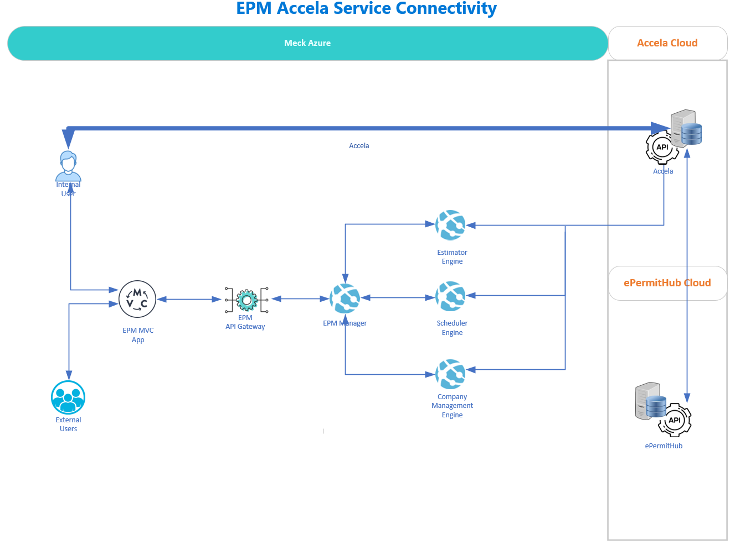

Slide 12
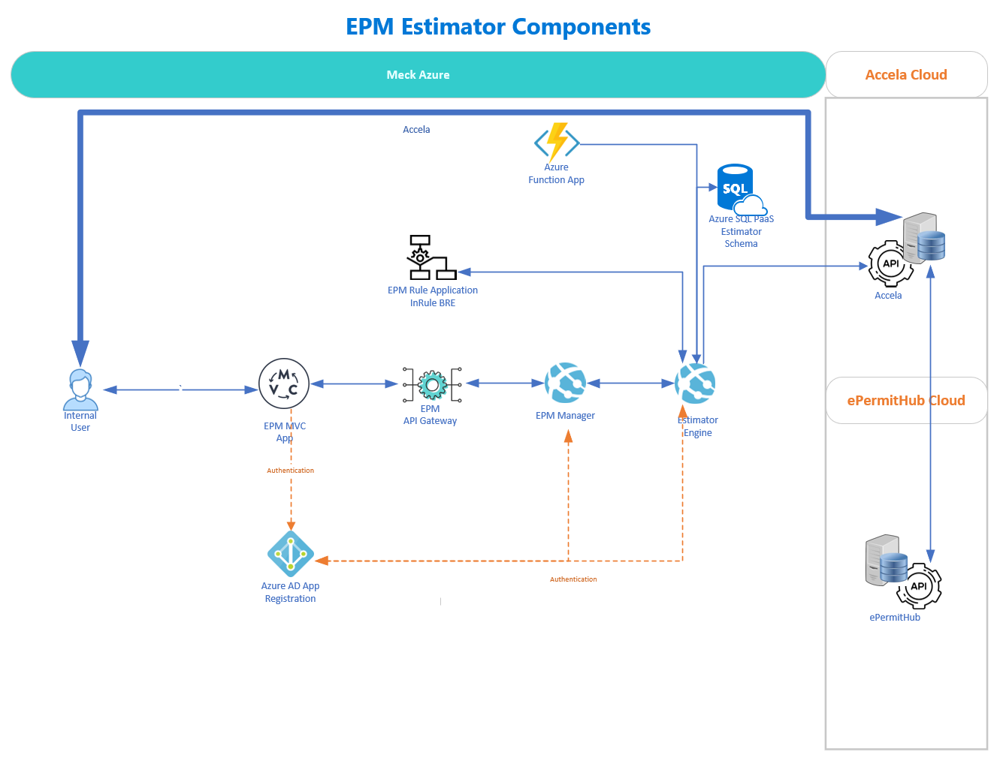

Slide 13
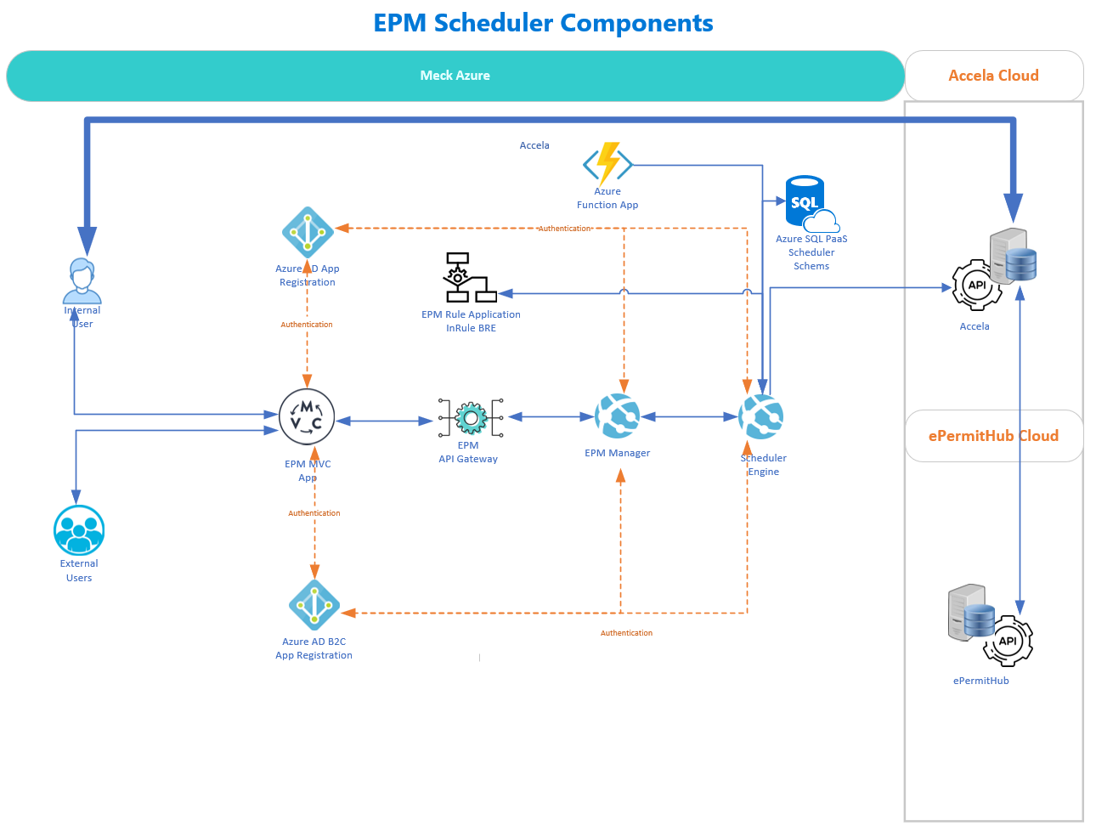

Slide 14
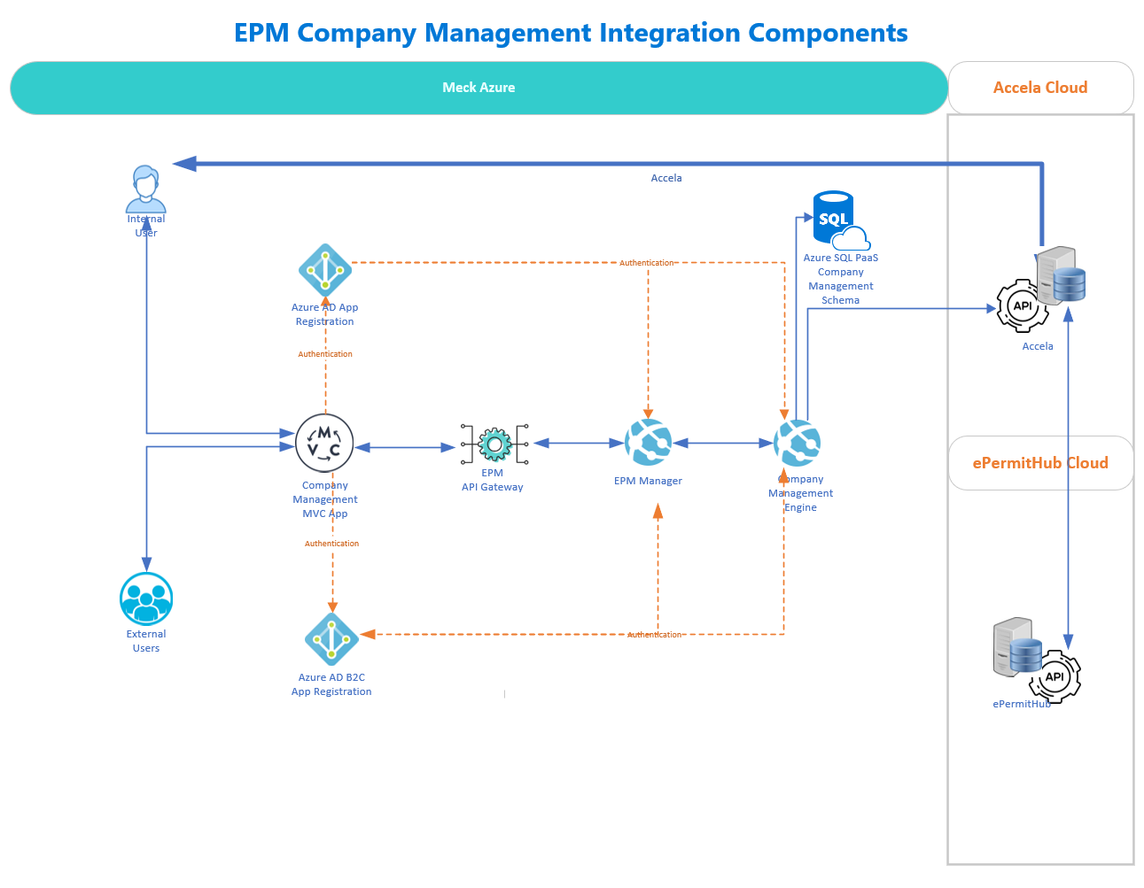

Slide 15
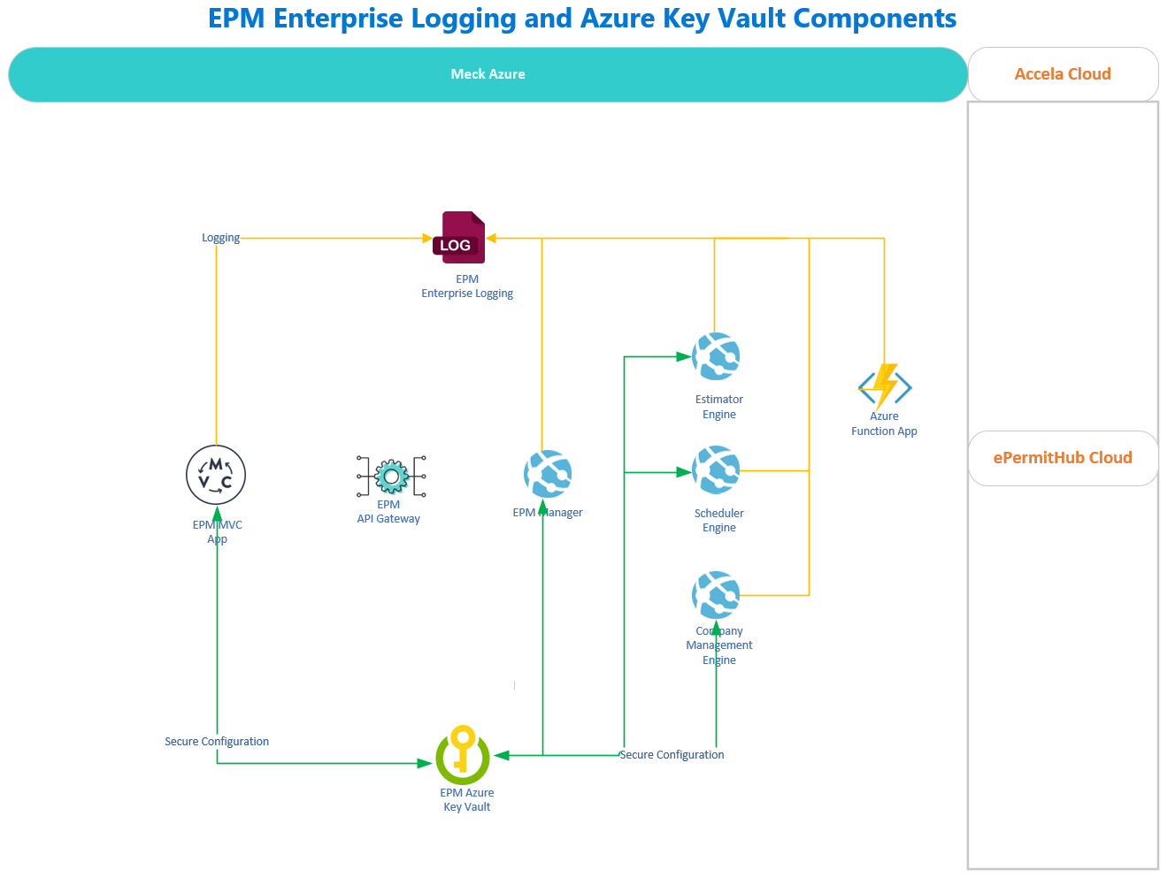

Slide 16
User Count by Type – 10 Year
User Count By Type | Year 1 | Year 2 | Year 3 | Year 4 | Year 5 | Year 6 | Year 7 | Year 8 | Year 9 | Year 10
Number of Users: Accela | 1500 | 1500 | 1500 | 1500 | 1500 | 1500 | 1500 | 1500 | 1500 | 1500
Number of Users: ePermitHub | 1500 | 1500 | 1500 | 1500 | 1500 | 1500 | 1500 | 1500 | 1500 | 1500
Number of Users: Company Management | 200 | 200 | 200 | 200 | 200 | 200 | 200 | 200 | 200 | 200
Number of Users: Estimator | 50 | 50 | 50 | 50 | 50 | 50 | 50 | 50 | 50 | 50
Number of Users: Scheduler | 50 | 50 | 50 | 50 | 50 | 50 | 50 | 50 | 50 | 50
Number of Users: InRule irAuthor | 3 | 3 | 1 | 1 | 1 | 1 | 1 | 1 | 1 | 1

Slide 17
Software, Infrastructure & Analytics Detail – 10 Year
 |  |  | Year 1 | Year 2 | Year 3 | Year 4 | Year 5 | Year 6 | Year 7 | Year 8 | Year 9 | Year 10
Software | Cost/Month | Size / # | Months | Months | Months | Months | Months | Months | Months | Months | Months | Months
InRule irAuthor License | 415 | 1 | 12 | 12 | 12 | 12 | 12 | 12 | 12 | 12 | 12 | 12
InRule Rule Application Traning | 3500 | 1 | 1 | 0 | 0 | 0 | 0 | 0 | 0 | 0 | 0 | 0
 |  |  | Year 1 | Year 2 | Year 3 | Year 4 | Year 5 | Year 6 | Year 7 | Year 8 | Year 9 | Year 10
Infrastructure | Cost/Month | Size / # | Months | Months | Months | Months | Months | Months | Months | Months | Months | Months
Azure App Service Plan (dev/tst/qa) (Size S1) | 74.4 | 1 | 6 | 12 | 12 | 12 | 12 | 12 | 12 | 12 | 12 | 12
Azure App Service Plan (prd) (Size S2) | 148.8 | 1 | 0 | 6 | 12 | 12 | 12 | 12 | 12 | 12 | 12 | 12
API Gateway (Developer) | 48.04 | 1 | 6 | 12 | 12 | 12 | 12 | 12 | 12 | 12 | 12 | 12
SQL PaaS (dev/tst/qa) (Size: 50 DTU) | 73.61 | 1 | 6 | 12 | 12 | 12 | 12 | 12 | 12 | 12 | 12 | 12
SQL PaaS (prd) (Size: 50 DTU) | 73.61 | 1 | 6 | 12 | 12 | 12 | 12 | 12 | 12 | 12 | 12 | 12
Azure Function | 18 | 1 | 6 | 12 | 12 | 12 | 12 | 12 | 12 | 12 | 12 | 12
 |  |  | Year 1 | Year 2 | Year 3 | Year 4 | Year 5 | Year 6 | Year 7 | Year 8 | Year 9 | Year 10
Analytics | Cost/Month | Size / # | Months | Months | Months | Months | Months | Months | Months | Months | Months | Months
Compute | 3.5 | 1 | 6 | 12 | 12 | 12 | 12 | 12 | 12 | 12 | 12 | 12
Analytics | 5.1 | 1 | 6 | 12 | 12 | 12 | 12 | 12 | 12 | 12 | 12 | 12
Cloud Storage per GB w/10,000 trans/month (est) | 0.0308 | 1 | 6 | 12 | 12 | 12 | 12 | 12 | 12 | 12 | 12 | 12
Accumulated Storage Size (in GB) |  |  | 100 | 200 | 300 | 400 | 500 | 600 | 700 | 800 | 900 | 1000
 |  |  | $18.48 | $73.92 | $110.88 | $147.84 | $184.80 | $221.76 | $258.72 | $295.68 | $332.64 | $369.60

Slide 18
Labor Costs – 10 Year
Labor Hours Consulting (hard) | Cost/Hour |  | Year 1 | Year 2 | Year 3 | Year 4 | Year 5 | Year 6 | Year 7 | Year 8 | Year 9 | Year 10
Consulting - PM | 100 | PM Resource Count | 1 | 0 | 0 | 0 | 0 | 0 | 0 | 0 | 0 | 0
 |  | Hours | 860 | 0 | 0 | 0 | 0 | 0 | 0 | 0 | 0 | 0
 |  |  | $86,000.00 | $0.00 | $0.00 | $0.00 | $0.00 | $0.00 | $0.00 | $0.00 | $0.00 | $0.00
Consulting - QA | 85 | QA Resource Count | 0 | 0 | 0 | 0 | 0 | 0 | 0 | 0 | 0 | 0
 |  | Hours | 0 | 0 | 0 | 0 | 0 | 0 | 0 | 0 | 0 | 0
 |  |  | $0.00 | $0.00 | $0.00 | $0.00 | $0.00 | $0.00 | $0.00 | $0.00 | $0.00 | $0.00
Consulting - DEV | 125 | DEV Resource Count | 2 | 0 | 0 | 0 | 0 | 0 | 0 | 0 | 0 | 0
 |  | Hours | 1720 | 0 | 0 | 0 | 0 | 0 | 0 | 0 | 0 | 0
 |  |  | $430,000.00 | $0.00 | $0.00 | $0.00 | $0.00 | $0.00 | $0.00 | $0.00 | $0.00 | $0.00
Total |  |  | $516,000.00 | $0.00 | $0.00 | $0.00 | $0.00 | $0.00 | $0.00 | $0.00 | $0.00 | $0.00
Labor Hours Internal (soft) | Cost/Hour |  | Year 1 | Year 2 | Year 3 | Year 4 | Year 5 | Year 6 | Year 7 | Year 8 | Year 9 | Year 10
Consulting - PM | 72 | PM Resource Count | 0 | 0 | 0 | 0 | 0 | 0 | 0 | 0 | 0 | 0
 |  | Hours | 0 | 0 | 0 | 0 | 0 | 0 | 0 | 0 | 0 | 0
 |  |  | $0.00 | $0.00 | $0.00 | $0.00 | $0.00 | $0.00 | $0.00 | $0.00 | $0.00 | $0.00
Consulting - QA | 72 | QA Resource Count | 1 | 1 | 1 | 1 | 1 | 1 | 1 | 1 | 1 | 1
 |  | Hours | 860 | 250 | 250 | 250 | 250 | 250 | 250 | 250 | 250 | 250
 |  |  | $61,920.00 | $18,000.00 | $18,000.00 | $18,000.00 | $18,000.00 | $18,000.00 | $18,000.00 | $18,000.00 | $18,000.00 | $18,000.00
Consulting - DEV | 72 | DEV Resource Count | 2 | 1 | 1 | 1 | 1 | 1 | 1 | 1 | 1 | 1
 |  | Hours | 1720 | 500 | 500 | 500 | 500 | 500 | 500 | 500 | 500 | 500
 |  |  | $247,680.00 | $36,000.00 | $36,000.00 | $36,000.00 | $36,000.00 | $36,000.00 | $36,000.00 | $36,000.00 | $36,000.00 | $36,000.00
Total |  |  | $309,600.00 | $54,000.00 | $54,000.00 | $54,000.00 | $54,000.00 | $54,000.00 | $54,000.00 | $54,000.00 | $54,000.00 | $54,000.00

Slide 19
EPM Accela - High Level Cost Estimate – 10 Year Breakout by Cost Type
Cost Category (Hard) |  |  | Year 1 | Year 2 | Year 3 | Year 4 | Year 5 | Year 6 | Year 7 | Year 8 | Year 9 | Year 10
Software |  |  | $18,440.00 | $14,940.00 | $4,980.00 | $4,980.00 | $4,980.00 | $4,980.00 | $4,980.00 | $4,980.00 | $4,980.00 | $4,980.00
Infrastructure |  |  | $1,725.96 | $4,344.72 | $5,237.52 | $5,237.52 | $5,237.52 | $5,237.52 | $5,237.52 | $5,237.52 | $5,237.52 | $5,237.52
Analytics |  |  | $70.08 | $177.12 | $214.08 | $251.04 | $288.00 | $324.96 | $361.92 | $398.88 | $435.84 | $472.80
Consulting - Labor |  |  | $516,000.00 | $0.00 | $0.00 | $0.00 | $0.00 | $0.00 | $0.00 | $0.00 | $0.00 | $0.00
 |  |  | $536,236.04 | $19,461.84 | $10,431.60 | $10,468.56 | $10,505.52 | $10,542.48 | $10,579.44 | $10,616.40 | $10,653.36 | $10,690.32

Slide 20
EPM Accela - High Level Cost Estimate – 10 Year Total
Cost Category (Soft) |  |  | Year 1 | Year 2 | Year 3 | Year 4 | Year 5 | Year 6 | Year 7 | Year 8 | Year 9 | Year 10
Internal - Labor |  |  | $309,600.00 | $54,000.00 | $54,000.00 | $54,000.00 | $54,000.00 | $54,000.00 | $54,000.00 | $54,000.00 | $54,000.00 | $54,000.00
 | Hard | Soft | Total
Year 1 | $536,236.04 | $309,600.00 | $845,836.04
Year 2 | $19,461.84 | $54,000.00 | $73,461.84
Year 3 | $10,431.60 | $54,000.00 | $64,431.60
Year 4 | $10,468.56 | $54,000.00 | $64,468.56
Year 5 | $10,505.52 | $54,000.00 | $64,505.52
Year 6 | $10,542.48 | $54,000.00 | $64,542.48
Year 7 | $10,579.44 | $54,000.00 | $64,579.44
Year 8 | $10,616.40 | $54,000.00 | $64,616.40
Year 9 | $10,653.36 | $54,000.00 | $64,653.36
Year 10 | $10,690.32 | $54,000.00 | $64,690.32
Total | $587,103.56 | $525,600.00 | $1,112,703.56

Slide 21
Preliminary Milestones (include RFP and POC efforts in needed)
Milestone 1: Solution Assessment, Business Requirements and Design – 12 weeks
Milestone 2: 1 week of InRule Training and 1 sprint of Meck Framework – 4 weeks
Milestone 3: 12 Development Sprints, each sprint at 3 weeks – 36 weeks
Environment Build Out – 2 weeks
Milestone 4: Quality Assurance Testing (QAT) – 6 weeks
Milestone 5: User Acceptance Testing (UAT) – 4 weeks
Milestone 6: End User Training – 2 weeks
1 Post Implementation Sprint – 3 weeks
Additional development Sprints may be recommended based on discovery in Milestone 1.

